Slide 1

Breaking Barriers: Making Preventive Healthcare Affordable
AAVISHKAR
Inter-Collegiate/Institute/Department Research Convention
Category:
Level : UG
Slot No:

Slide 2

Abstract
2
This study examines factors affecting participation in preventive health screenings, including cost, income, awareness, and time constraints.
Results reveal that high costs and low-income levels significantly reduce screening frequency, while reducing costs increases participation.
A moderate positive correlation between income and screening frequency was found. Incentives like tax benefits or insurance discounts were identified as motivators.
These findings highlight the need for affordable and accessible preventive healthcare solutions.

Slide 3

INTRODUCTION
3
Non-Communicable Diseases (NCDs) account for nearly 63% of all deaths in India as of 2023, including cardiovascular diseases (27%), cancers (9%), and chronic respiratory diseases (11%).
01
Around 25–30% of deaths in India are linked to conditions that could have been mitigated with regular health check-ups.
02
As of 2023, about 55% of healthcare expenses in India are out-of-pocket, making preventive check-ups unaffordable for many.
03

Slide 4

OBJECTIVES
4
To analyze the impact of cost, income, and awareness on participation in preventive health check-ups.
To identify barriers faced by different groups in accessing regular health screenings.
To propose practical solutions for making preventive healthcare more affordable and accessible.

Slide 5

METHODOLOGY
5
Sampling Method:
A randomized stratified sampling technique was used with a total sample size of 370 participants, ensuring balanced representation across age groups, with 50 individuals from each group.
Data Collection:
Data was collected using a semi-structured questionnaire, distributed both online via Google Forms and offline to include higher age groups and underserved populations. The survey focused on factors like cost, income, and barriers to health screenings.
Statistical Analysis:
Chi-squared tests, proportion tests, and correlation analysis were performed to study the relationships between cost, income, and participation frequency.
Proposed Solutions:
Based on the findings, solutions like mandatory check-ups, incentives, and an app-based system were proposed to improve participation and accessibility in preventive healthcare.

Slide 6
6
42% of people are unaware of the cost, indicating a need for greater awareness.
Higher-income individuals (above ₹8,00,000) tend to spend more on health checkups, while lower-income groups prefer lower-cost options, indicating cost sensitivity based on income.

Slide 7
7
Cost and time both impact health screenings, with cost having a slightly higher influence at mid-range levels.
The graph shows that cost, time, and lack of awareness are key barriers to regular health checkups. Addressing these through affordable care, flexible schedules, and awareness campaigns can improve health outcomes.

Slide 8
Hypothesis Results
8
We wanted to see if lowering the cost of full-body checkups would encourage more people to participate in health screenings.
What we tested : More than 50% would participate after lowering costs.
What we found:
The p-value of 0.000003554 from the 1-sample proportion test is much smaller than 0.05, indicating the result is statistically significant.
This shows strong evidence that reducing costs increases the number of people willing to participate in health screenings.
Conclusion: Reducing the cost of checkups significantly increases participation in health screenings, with more than half of the population willing to participate.

Slide 9
Hypothesis Results
9
We wanted to check if the cost of full-body checkups impacts how often people go for preventive health screenings.
What we tested : High costs discourage people from getting regular health checkups.
What we found:
The chi-squared test showed a strong link between the cost of checkups and how often people get screened. The p-value of 0.0091 is much smaller than the usual cutoff of 0.05, indicating the result is statistically significant.
Conclusion: High costs significantly reduce how often people go for preventive health screenings. Reducing the cost may encourage more frequent participation.

Slide 10
Hypothesis Results
10
We wanted to see if income levels influence how often people go for preventive health screenings.
What we tested : Income levels do impact the frequency of health screenings.
What we found:
The Pearson correlation test showed a moderate positive correlation between income and health screening frequency (correlation = 0.298)
The p-value of 1.554e-06 is much smaller than 0.05, indicating the result is statistically significant.
Conclusion: There is a significant link between income levels and how often people go for preventive health screenings. Higher income is associated with a greater likelihood of regular screenings.

Slide 11
SOLUTIONS
11
The app offers a comprehensive healthcare platform with features designed to improve access to preventive health check-ups and make them more affordable and accessible:
Registration: Users can easily register and access the app's services.
AI-Driven Report Analysis: AI analyzes health reports, providing personalized insights and recommendations.
Health Check-Up Reminders: Regular reminders ensure users stay on track with their check-ups.

Slide 12
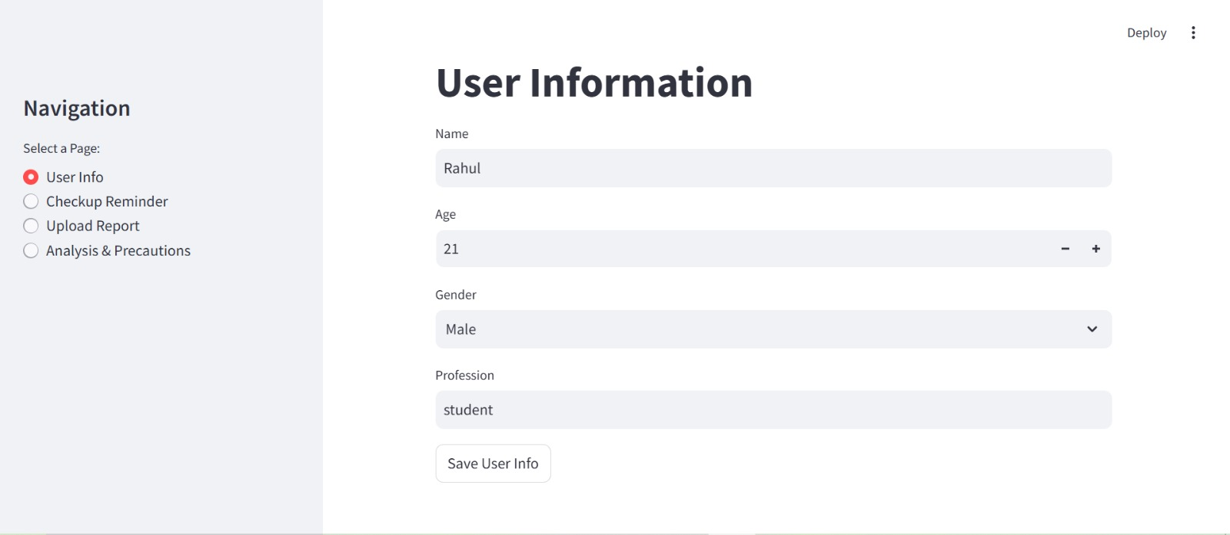
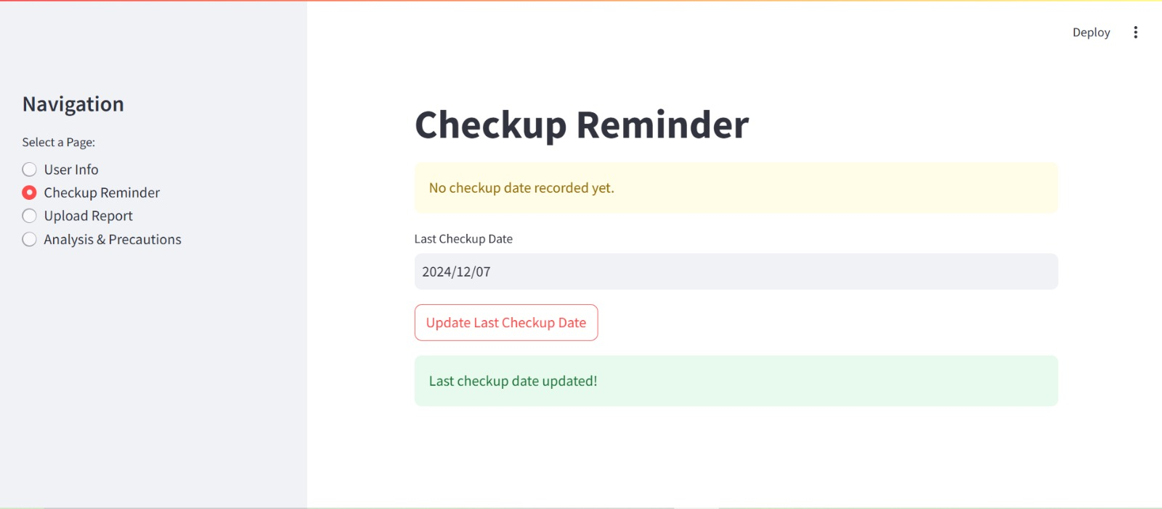
Features
12
Registration
Health Check-Up Reminders

Slide 13
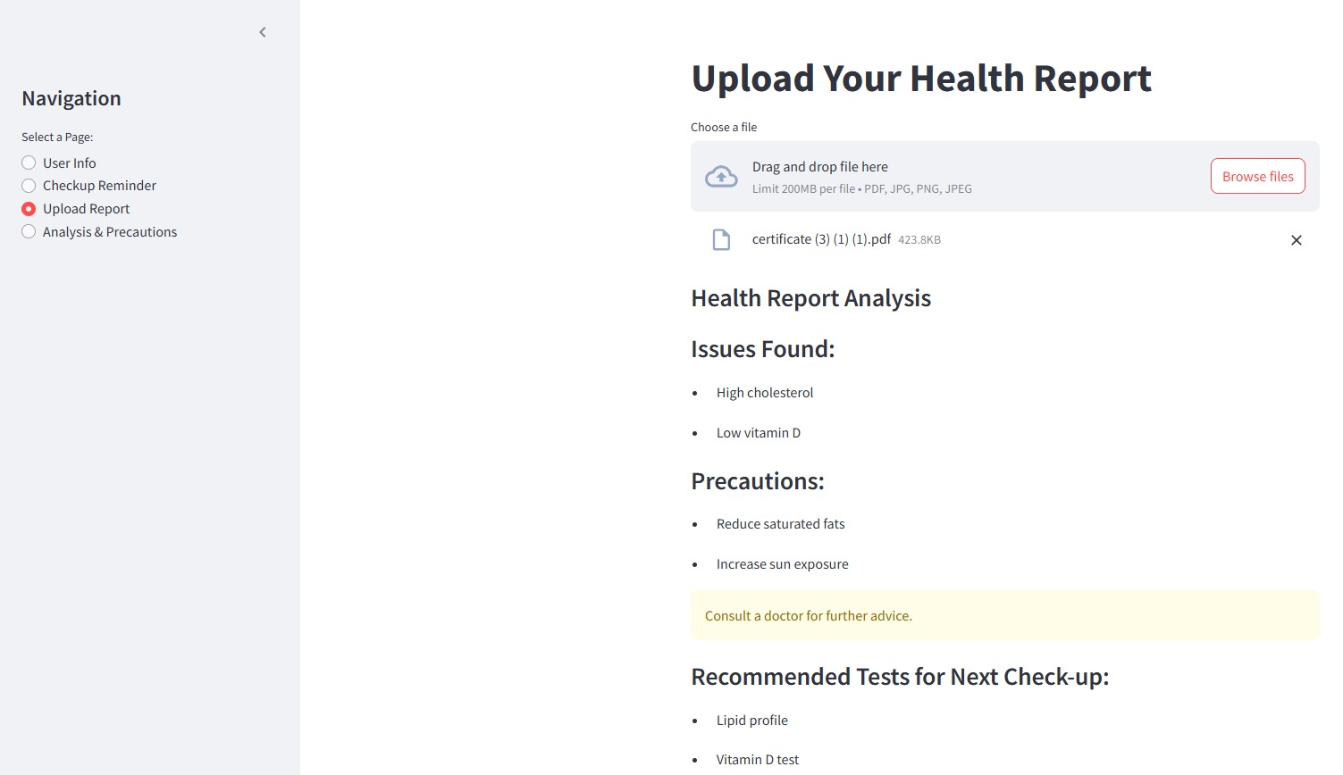
Features
13
AI-Driven Report Analysis

Slide 14
Reasons to Make Preventive Health Check-Ups Mandatory:
14
Early Detection of Diseases: Regular check-ups help catch diseases early, allowing time for treatment and preventing potential epidemics or pandemics (e.g., COVID-19).
Cost Reduction: Early treatment of health issues is cheaper than treating advanced diseases, reducing overall healthcare costs.
Reduced Healthcare Burden: Preventive care helps avoid critical health situations, reducing the strain on emergency services and hospitals.
Better Public Health: Regular check-ups encourage proactive health management, helping individuals prevent diseases.
Workforce Productivity: Healthy employees are more productive, reducing absenteeism and improving economic outcomes.
Health Equity: Making check-ups mandatory ensures more people, regardless of income, have access to preventive care, promoting equality in healthcare.

Slide 15
Solutions to Make Preventive Health Check-Ups Mandatory
15
Retirees:
Solution: Require retirees to submit annual health check-up reports with life certificates for pension.
Benefit: Encourages regular health monitoring and links check-ups to pension disbursements for their well-being.
Employees:
Solution: Make annual health check-ups mandatory for employees to qualify for bonuses.
Benefit: Promotes regular health monitoring, reducing absenteeism and improving productivity.
Students:
Solution: Mandate health check-ups every 2-3 years, with loyalty points earned for timely check-ups, redeemable for discounted travel in India.
Benefit: Encourages health prioritization and rewards regular check-ups with travel incentives.

Slide 16
Solutions to Make Preventive Health Check-Ups Mandatory
16
Non-Employed/Housewives:
Solution: Offer a loyalty card for regular check-ups, with points redeemable for discounts on goods.
Benefit: Incentivizes non-employed individuals to stay on top of their health and participate in check-ups.
Business Owners:
Solution: Offer tax discounts for business owners who complete regular health check-ups.
Benefit: Links health monitoring to financial benefits, encouraging business owners to prioritize their health.

Slide 17
Effect on Costs for Preventive Health Check-Ups:
17
Cost Reduction: Regular check-ups detect health issues early, reducing the need for expensive treatments and lowering overall healthcare costs.
1
Affordable Options: Price comparisons between private and government labs help individuals choose affordable options, cutting out-of-pocket expenses.
2
Better Resource Utilization: Early detection optimizes healthcare resources, reducing unnecessary hospitalizations.
3
Long-Term Savings: Early screenings prevent chronic diseases, saving long-term healthcare costs.
4
Incentives to Lower Costs: Loyalty points and rewards for regular check-ups encourage participation and provide discounts, further reducing costs.
5
In conclusion, mandatory preventive check-ups are likely to reduce both individual and system-wide healthcare costs by preventing the escalation of health issues, improving resource efficiency, and promoting more affordable care.

Slide 18

FUTURE PLANS
18
Slot Booking: Enable users to schedule health check-ups at their preferred time.
Loyalty Points: Reward users with redeemable points for regular check-ups.
Price Comparison: Allow users to compare private and government lab costs for affordability.
Diet Recommendations: Provide AI-based personalized diet plans based on health reports.
Lab Locator: Include a map to locate nearby labs with addresses.
Age-Specific Packages: Offer customized health check-up packages for different age groups.

Slide 19
Overall Conclusion:
19
Mandatory Preventive Health Check-Ups will improve public health and promote early disease detection.
Tailored solutions for different age and occupation groups will ensure accessibility and encourage regular health monitoring.
These measures will help reduce healthcare costs by preventing serious health issues through early detection.
Increased health awareness will lead to healthier lifestyles and proactive care.
Early detection can prevent epidemics and pandemics, saving lives and healthcare resources.
Overall, these solutions will contribute to a sustainable and efficient healthcare system, benefiting both individuals and society as a whole.

Slide 20
Thank you!!!

